Slide 1
Reinforcement Learning

Slide 2
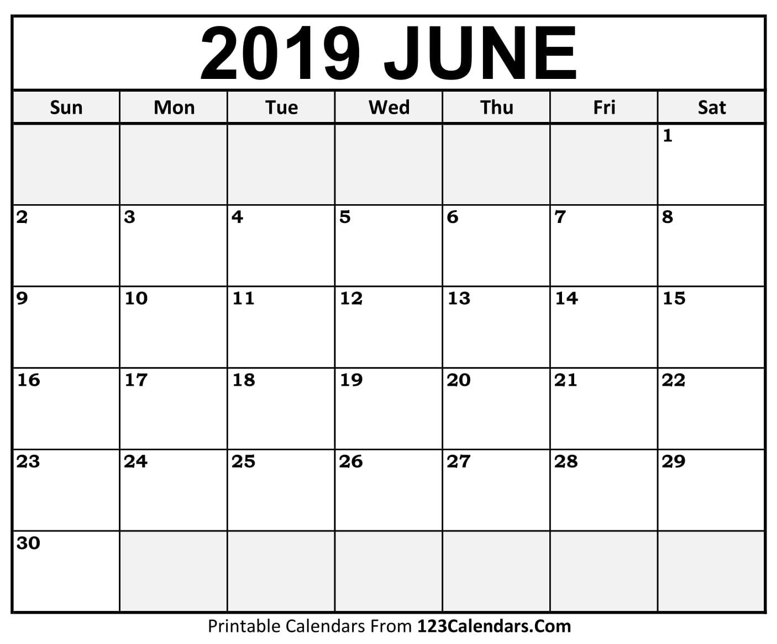
Self-directed learning
Self-directed learning
Self-directed learning
Exam 2
Review
Ethics
Debate
(optional)
Exam 2
Plan for remaining of semester

Slide 3
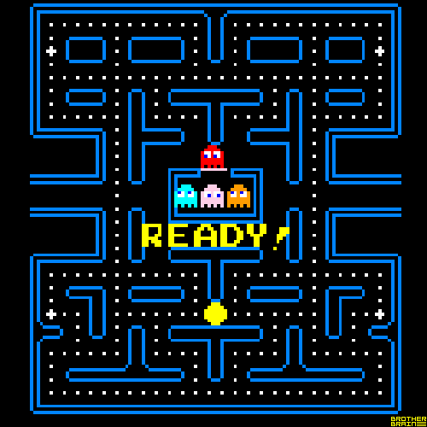
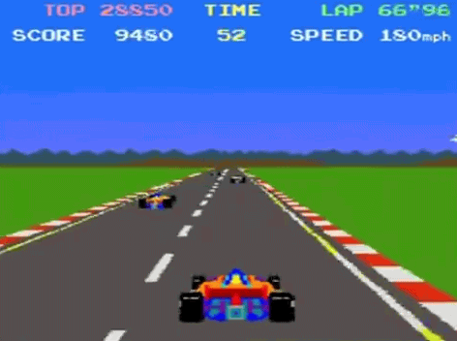
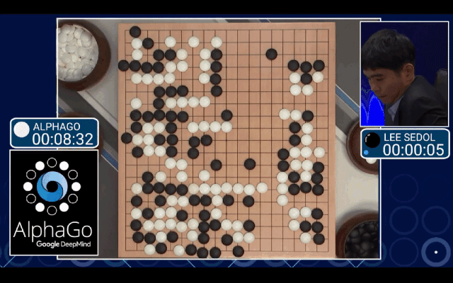
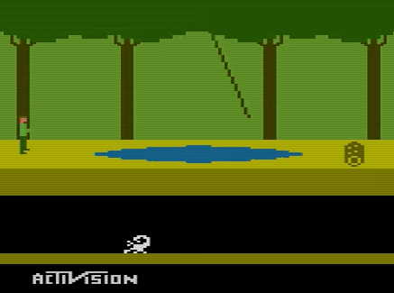
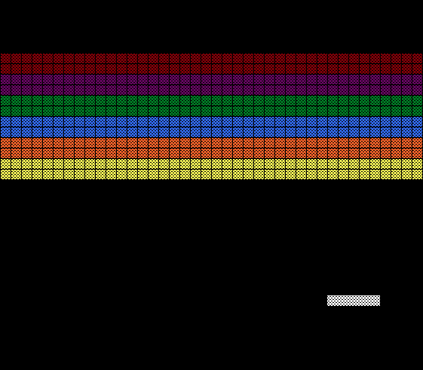
Introduction
Reinforcement Learning (RL) is one of the most exciting fields of Machine Learning today, and also one of the oldest.
It has been around since the 1950s, producing many interesting applications over the years,in particular in games (e.g., TD-Gammon, a Backgammon playing program) and in machine control, but seldom making the headline news.
But a revolution took place in 2013 when researchers from an English startup called DeepMind demonstrated a system that could learn to play just about any Atari game from scratch, eventually outperforming humans in most of them, using only raw pixels as inputs and without any prior knowledge of the rules of the games.
This was the first of a series of amazing feats, culminating in March 2016 with the victory of their system AlphaGo against Lee Sedol, the world champion of the game of Go.
No program had ever come close to beating a master of this game, let alone the world champion.
This occurred in a game that was thought too difficult for machines to learn.
Today the whole field of RL is boiling with new ideas, with a wide range of applications.
DeepMind was bought by Google for over 500 million dollars in 2014.

Slide 4
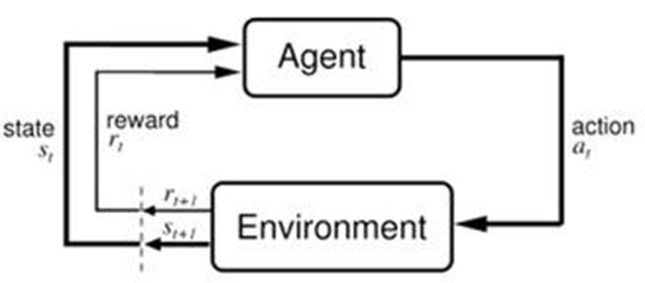
Learning to optimize rewards
In Reinforcement Learning, a software agent makes observations and takes actions within an environment, and in return it receives rewards (-punishments).
Its objective is to learn to act in a way that will maximize its expected long-term rewards.
Huge implications for robotics
Notes:
This is quite a broad setting, which can apply to a wide variety of tasks. Here are a few examples :
The agent can be the program controlling a walking robot. In this case, the environment is the real world, the agent observes the environment through a set of sensors such as cameras and touch sensors, and its actions consist of sending signals to activate motors. It may be programmed to get positive rewards whenever it approaches the target destination, and negative rewards whenever it wastes time, goes in the wrong direction, or falls down.
The agent can be the program controlling Ms. Pac-Man. In this case, the environment is a simulation of the Atari game, the actions are the nine possible joystick positions (upper left, down, center, and so on), the observations are screenshots, and the rewards are just the game points.
Similarly, the agent can be the program playing a board game such as the game of Go.
The agent does not have to control a physically (or virtually) moving thing. For example, it can be a smart thermostat, getting rewards whenever it is close to the target temperature and saves energy, and negative rewards when humans need to tweak the temperature, so the agent must learn to anticipate human needs.
The agent can observe stock market prices and decide how much to buy or sell every second. Rewards are obviously the monetary gains and losses.

Slide 5
Policy search
The algorithm used by the software agent to determine its actions is called its policy.
For example, the policy could be a neural network taking observations as inputs and outputting the action to take

Slide 6
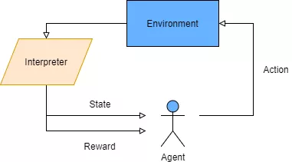
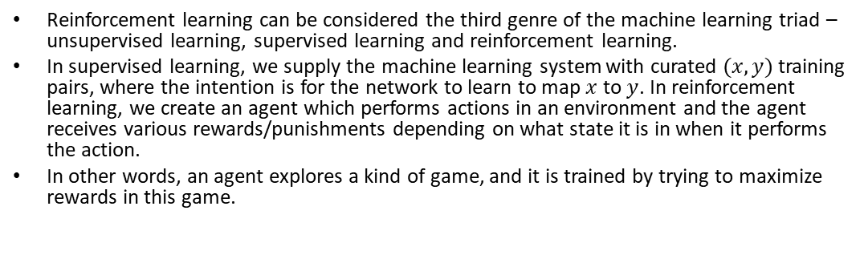
Reinforcement learning- the basics
Reinforcement learning can be considered the third genre of the machine learning triad – unsupervised learning, supervised learning and reinforcement learning.
In supervised learning, we supply the machine learning system with curated $(x, y)$ training pairs, where the intention is for the network to learn to map $x$ to $y$. In reinforcement learning, we create an agent which performs actions in an environment and the agent receives various rewards/punishments depending on what state it is in when it performs the action.
In other words, an agent explores a kind of game, and it is trained by trying to maximize rewards in this game.

Slide 7
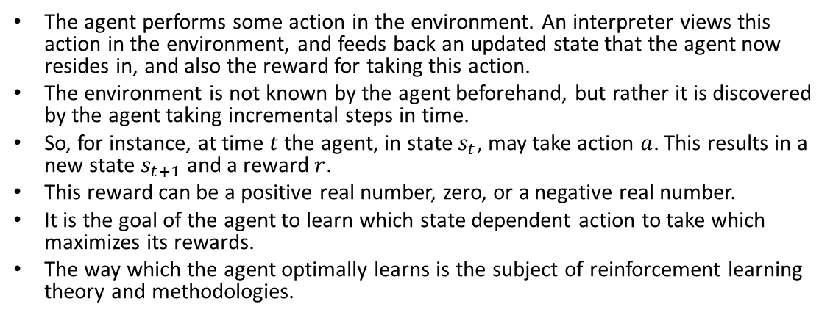
Reinforcement learning- the basics
The agent performs some action in the environment. An interpreter views this action in the environment, and feeds back an updated state that the agent now resides in, and also the reward for taking this action.
The environment is not known by the agent beforehand, but rather it is discovered by the agent taking incremental steps in time.
So, for instance, at time $t$the agent, in state $s_{t}$, may take action $a$. This results in a new state $s_{t+1}$ and a reward $r$.
This reward can be a positive real number, zero, or a negative real number.
It is the goal of the agent to learn which state dependent action to take which maximizes its rewards.
The way which the agent optimally learns is the subject of reinforcement learning theory and methodologies.

Slide 8
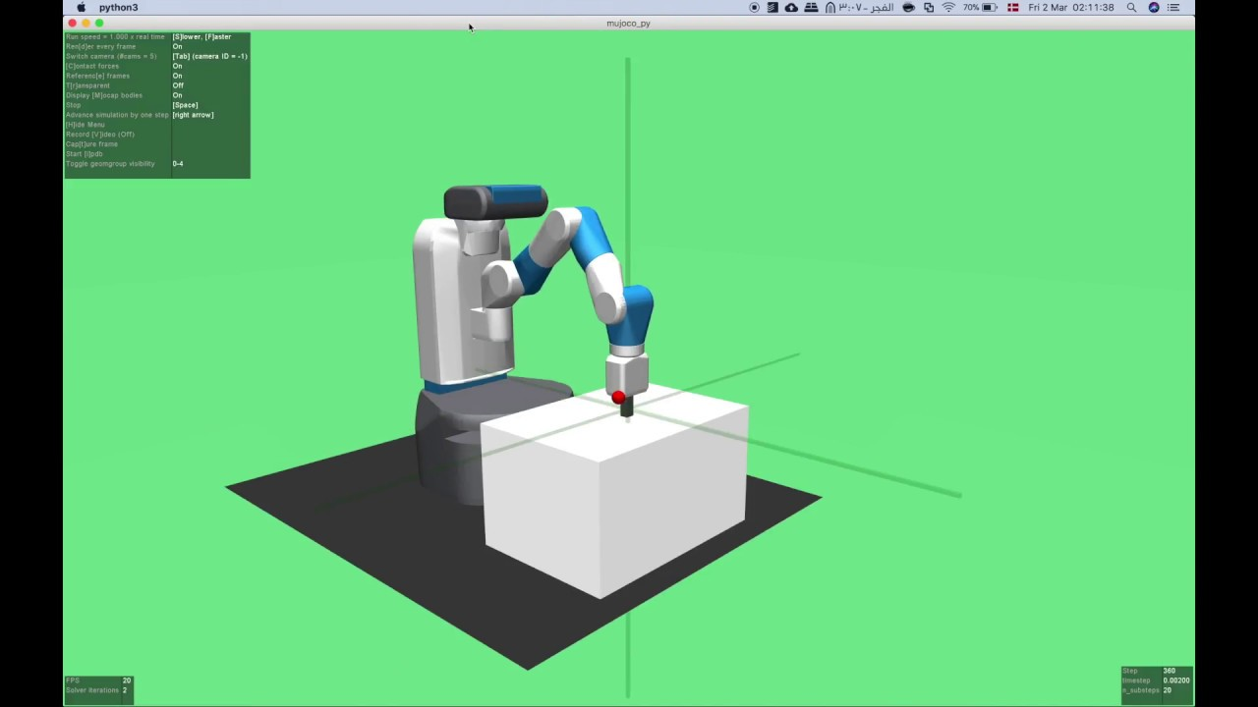
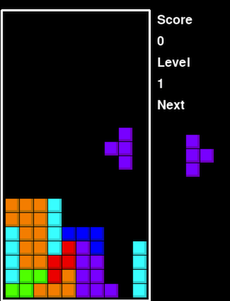
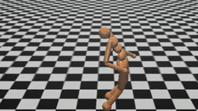
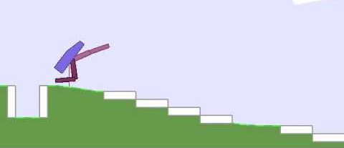
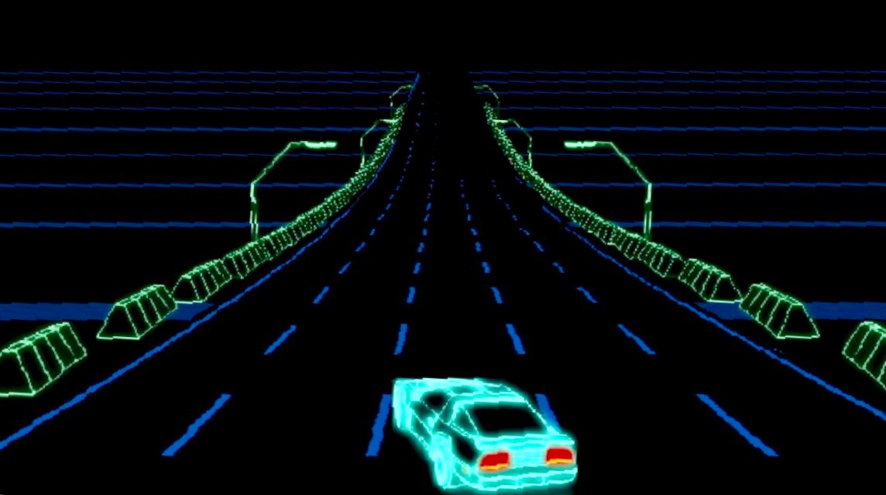
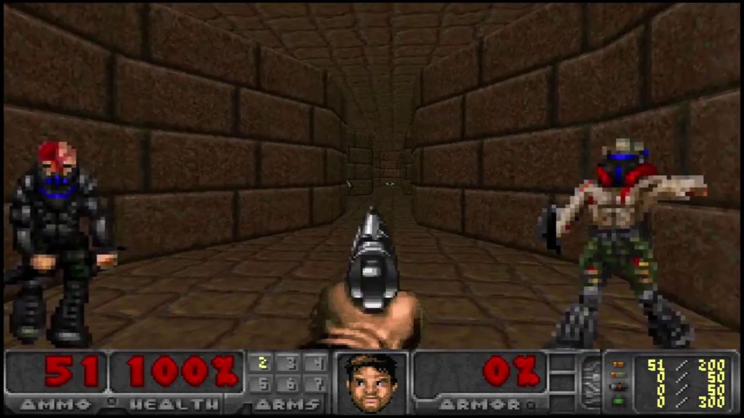
Introduction to OpenAI Gym
One of the challenges of Reinforcement Learning is that in order to train an agent, you first need to have a working environment.
If you want to program an agent that will learn to play an Atari game, you will need an Atari game simulator.
If you want to program a walking robot, then the environment is the real world and you can directly train your robot in that environment,
But this has its limits: if the robot falls off a cliff, you can’t just click “undo.”
You can’t speed up time either; adding more computing power won’t make the robot move any faster.
And it’s generally too expensive to train 1,000 robots in parallel.
In short, training is hard and slow in the real world, so you generally need a simulated environment at least to bootstrap training
OpenAI gym is a toolkit that provides a wide variety of simulated environments
(Atari games, board games, 2D and 3D physical simulations, and so on), so you can
train agents, compare them, or develop new RL algorithms.

Slide 9
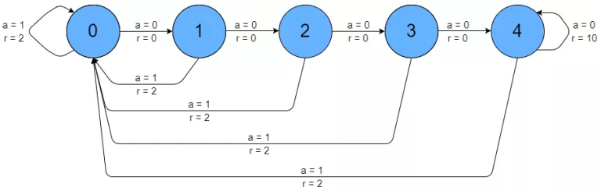
Open AI Gym Nchain environment
The NChain example on Open AI Gym is a simple 5 state environment.
There are two possible actions in each state, move forward (action 0) and move backwards (action 1).
When action 1 is taken, i.e. move backwards, there is an immediate reward of 2 given to the agent – and the agent is returned to state 0 (back to the beginning of the chain). However, when a move forward action is taken (action 0), there is no immediate reward until state 4. When the agent moves forward while in state 4, a reward of 10 is received by the agent.
The agent stays in state 4 at this point also, so the reward can be repeated.
There is also a random chance that the agent’s action is “flipped” by the environment (i.e. an action 0 is flipped to an action 1 and vice versa).

Slide 10
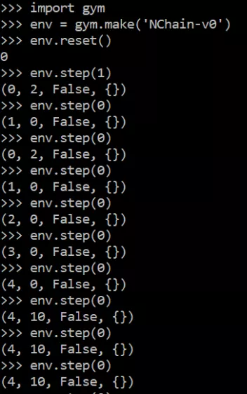
Nchain environment
You can play around with this environment by first installing the Open AI Gym Python package
Simply open up your Python command prompt and have a play
The environment is loaded via the gym.make() command.
The first step is to initalize / reset the environment by running env.reset() – this command returns the initial state of the environment – in this case 0.
The first command I then run is env.step(1) – the value in the bracket is the action ID
action 1 represents a step back to the beginning of the chain (state 0)
The step() command returns 4 variables in a tuple, these are (in order):
The new state after the action
The reward due to the action
Whether the game is “done” or not – the NChain game is done after 1,000 steps
Debugging information – not relevant in this example
starting in state 0 and taking step(1) action, the agent stays in state 0 and gets 2 for its reward.
Next, I sent a series of action 0 commands.
After every action 0 command, we would expect the progression of the agent along the chain, with the state increasing in increments (i.e. 0 -> 1 -> 2 etc.).
However, you’ll observe after the first step(0) command, that the agent stays in state 0 and gets a 2 reward. This is because of the random tendency of the environment to “flip” the action occasionally, so the agent actually performed a 1 action. This is just unlucky.
Random environmental flip
Notes:
When in state 4, an action of 0 will keep the agent in step 4 and give the agent a 10 reward. Not only that, the environment allows this to be done repeatedly, as long as it doesn’t produce an unlucky “flip”, which would send the agent back to state 0 – the beginning of the chain.

Slide 11
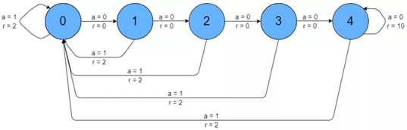
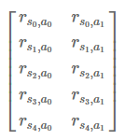
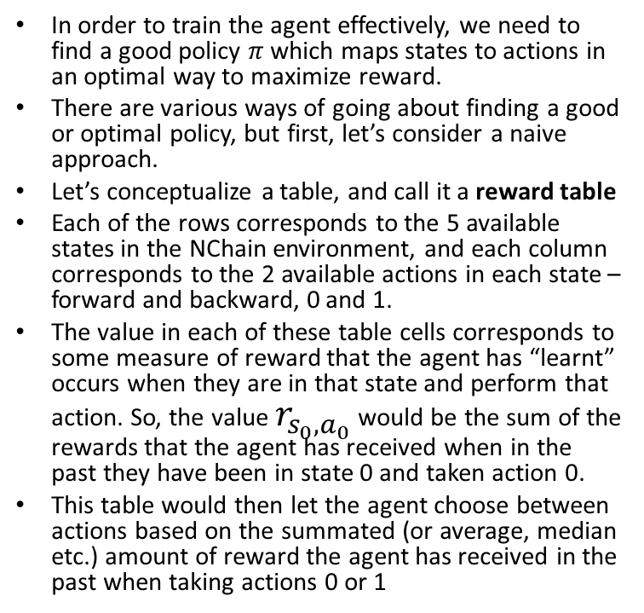
A first naive heuristic for reinforcement learning
In order to train the agent effectively, we need to find a good policy $π$ which maps states to actions in an optimal way to maximize reward.
There are various ways of going about finding a good or optimal policy, but first, let’s consider a naive approach.
Let’s conceptualize a table, and call it a reward table
Each of the rows corresponds to the 5 available states in the NChain environment, and each column corresponds to the 2 available actions in each state – forward and backward, 0 and 1.
The value in each of these table cells corresponds to some measure of reward that the agent has “learnt” occurs when they are in that state and perform that action. So, the value $r_{s_{0},a_{0}}$ would be the sum of the rewards that the agent has received when in the past they have been in state 0 and taken action 0.
This table would then let the agent choose between actions based on the summated (or average, median etc.) amount of reward the agent has received in the past when taking actions 0 or 1

Slide 12
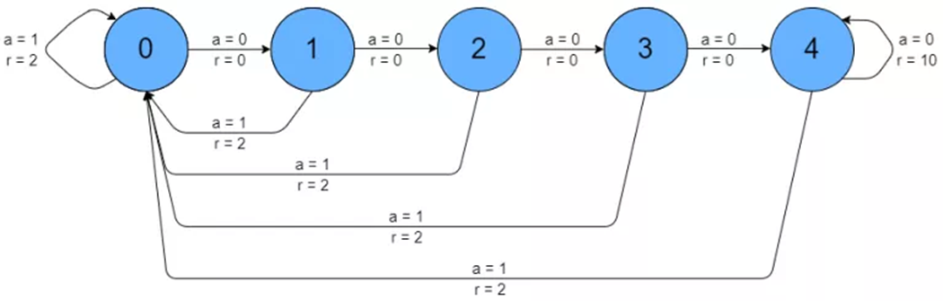
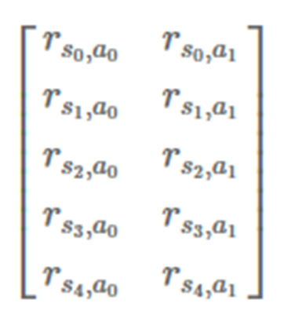
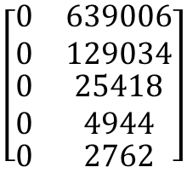
Reward table
if the agent is in state 0 and we have the reward table with values [100, 1000] for the first row, action 1 will be selected as the index with the highest value is column 1.
If we ran a naïve algorithm that simply tries to maximize immediate rewards, the reward table after a few iterations would look something the table on the right
Examining the results, you can observe that the most common state for the agent to be in is the first state, seeing as any action 1 will bring the agent back to this point. The least occupied state is state 4, as it is difficult for the agent to progress from state 0 to 4
Clearly – something is wrong with this table. One would expect that in state 4, the most rewarding action for the agent would be to choose action 0, which would reward the agent with 10 points, instead of the usual 2 points for an action of 1. Not only that, but it has chosen action 0 for all states – this goes against intuition – surely it would be best to sometimes shoot for state 4 by choosing multiple action 0’s in a row, and that way reap the reward of multiple possible 10 scores.
$$\left[\begin{matrix}\begin{matrix}0 \\ 0 \\ \begin{matrix}0 \\ 0\end{matrix}\end{matrix} & \begin{matrix}639006 \\ 129034 \\ \begin{matrix}25418 \\ 4944\end{matrix}\end{matrix} \\ 0 & 2762\end{matrix}\right]$$

Slide 13
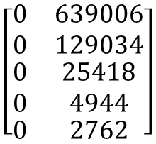
Reward table
There are a number of issues with this way of doing reinforcement learning:
Because no reward is obtained for most of the states when action 0 is picked, this model for training the agent has no way to encourage acting on delayed reward signal when it is appropriate for it to do so.
Once there is a reward stored in one of the columns, the agent will always choose that action from that point on. This will lead to the table being “locked in” with respect to actions after just a few steps in the game.
$$\left[\begin{matrix}\begin{matrix}0 \\ 0 \\ \begin{matrix}0 \\ 0\end{matrix}\end{matrix} & \begin{matrix}639006 \\ 129034 \\ \begin{matrix}25418 \\ 4944\end{matrix}\end{matrix} \\ 0 & 2762\end{matrix}\right]$$

Slide 14

Delayed rewards (i.e. future time orientation)
If you want to have a bachelor degree in IT, you’re going to have to go through some pain to get there.
You’ll be studying a long time before you get your degree, and the rewards will be low while you are doing so.
However, once you get to be a fully fledged BIT graduate, the rewards should be significant.
During your time studying, you are operating under a delayed reward or delayed gratification paradigm in order to reach that greater reward.
You might only be willing to undertake that period of delayed reward for a given period of time – you wouldn’t want to be studying forever, or at least, for decades.

Slide 15
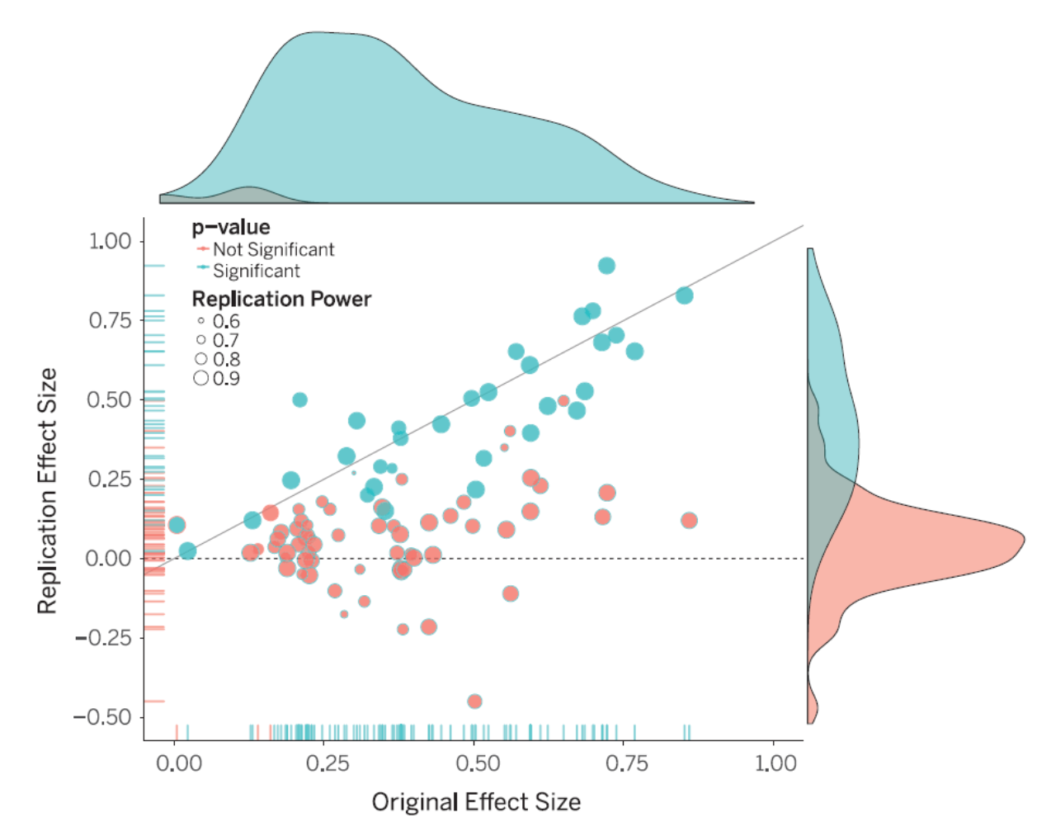
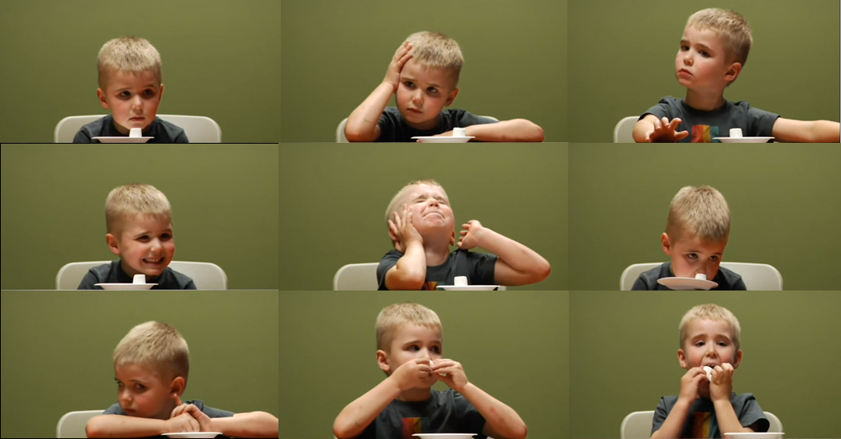
The marshmallow test
Notes:
Controls included measures of the child’s socioeconomic status, intelligence, personality, and behavior problems

Slide 16
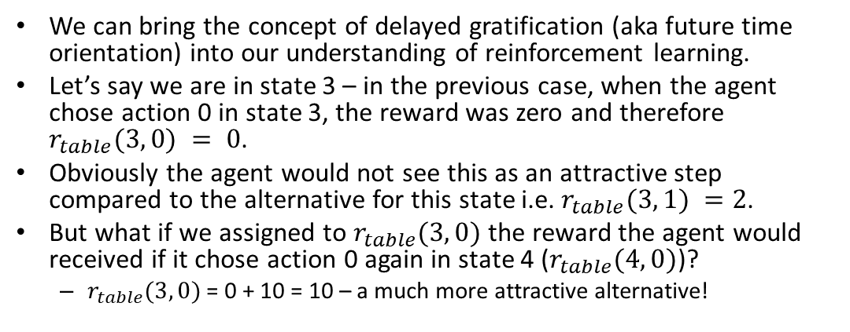
Delayed reward reinforcement learning
We can bring the concept of delayed gratification (aka future time orientation) into our understanding of reinforcement learning.
Let’s say we are in state 3 – in the previous case, when the agent chose action 0 in state 3, the reward was zero and therefore $r_{table}(3, 0) = 0$.
Obviously the agent would not see this as an attractive step compared to the alternative for this state i.e. $r_{table}(3, 1) =2$.
But what if we assigned to $r_{table}(3, 0)$ the reward the agent would received if it chose action 0 again in state 4 ($r_{table}(4, 0)$)?
$r_{table}(3, 0)$ = 0 + 10 = 10 – a much more attractive alternative!

Slide 17
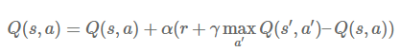
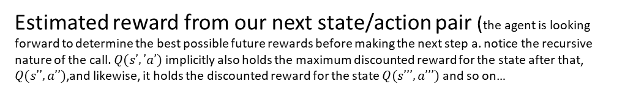
Q – learning algorithm
This idea of propagating possible reward from the best possible actions in future states is a core component of Q learning.
In Q learning, the Q value for each action in each state is updated when the relevant information is made available.
The Q learning (Q table updating rule) is:
Current Q-table value we are updating
Learning rate (restricts the updating to ensure it doesn’t “race” to a solution)
Reward hat was obtained when action $a$ was taken in state $s$
Discount factor (decreases the impact of future rewards on the immediate decision making in state s. This represents a limited patience in the agent – it won’t study forever to get that BIT degree.)
Estimated reward from our next state/action pair (the agent is looking forward to determine the best possible future rewards before making the next step a. notice the recursive nature of the call. $Q(s’,’a’)$implicitly also holds the maximum discounted reward for the state after that, $Q(s’’,a’’)$,and likewise, it holds the discounted reward for the state $Q(s’’’,a’’’)$ and so on…
Normalizes and restrict the growth of the Q value as the training of the agent progresses

Slide 18
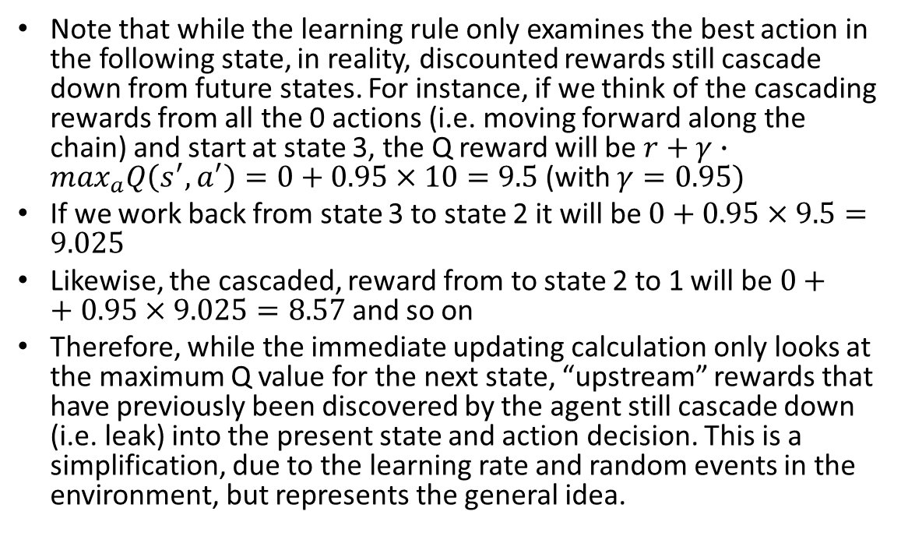
Rewards leaking
Note that while the learning rule only examines the best action in the following state, in reality, discounted rewards still cascade down from future states. For instance, if we think of the cascading rewards from all the 0 actions (i.e. moving forward along the chain) and start at state 3, the Q reward will be $r+γ∙\max_{a}Q\left(s^{′},a^{′}\right)=0+0.95×10=9.5$ (with $γ=0.95)$
If we work back from state 3 to state 2 it will be $0+0.95×9.5=9.025$
Likewise, the cascaded, reward from to state 2 to 1 will be $0++0.95×9.025=8.57$ and so on
Therefore, while the immediate updating calculation only looks at the maximum Q value for the next state, “upstream” rewards that have previously been discovered by the agent still cascade down (i.e. leak) into the present state and action decision. This is a simplification, due to the learning rate and random events in the environment, but represents the general idea.

Slide 19
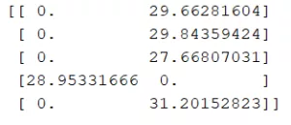
The limitations of not exploring enough
After we ran the previous algorithm with rewards looking we get the adjacent Q table output
we would expect at least the state 4 – action 0 combination to have the highest Q score, but it doesn’t.
We might also expect the reward from this action in this state to have cascaded down through the states 0 to 3.
Something has clearly gone wrong – and the answer is that there isn’t enough exploration going on within the agent training method.

Slide 20
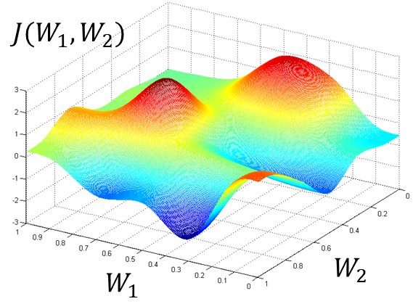
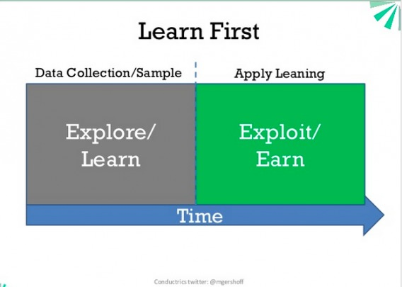
Exploration versus exploitation
At the beginning of an optimization problem, it is best to allow the problem space to be explored extensively in the hope of finding good local (or even global) minima.
However, once the problem space has been adequately searched, it is now best for the optimization algorithm to focus on exploiting what it has found by converging on the best minima to arrive at a good solution.
Therefore, in reinforcement learning, it is best to allow some randomness in the action selection at the beginning of the training.
This randomness is determined by the epsilon parameter. Essentially, a random number is drawn between 0 and 1, and if it is less than epsilon, then a random action is selection. If not, an action is selected based on the output of the neural network. The epsilon variable usually starts somewhere close to 1, and is slowly decayed to somewhere around 0 during training. This allows a large exploration of the game at the beginning, but then the decay of the epsilon value allows the network to zero in on a good solution

Slide 21
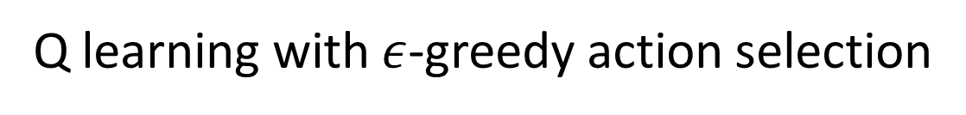
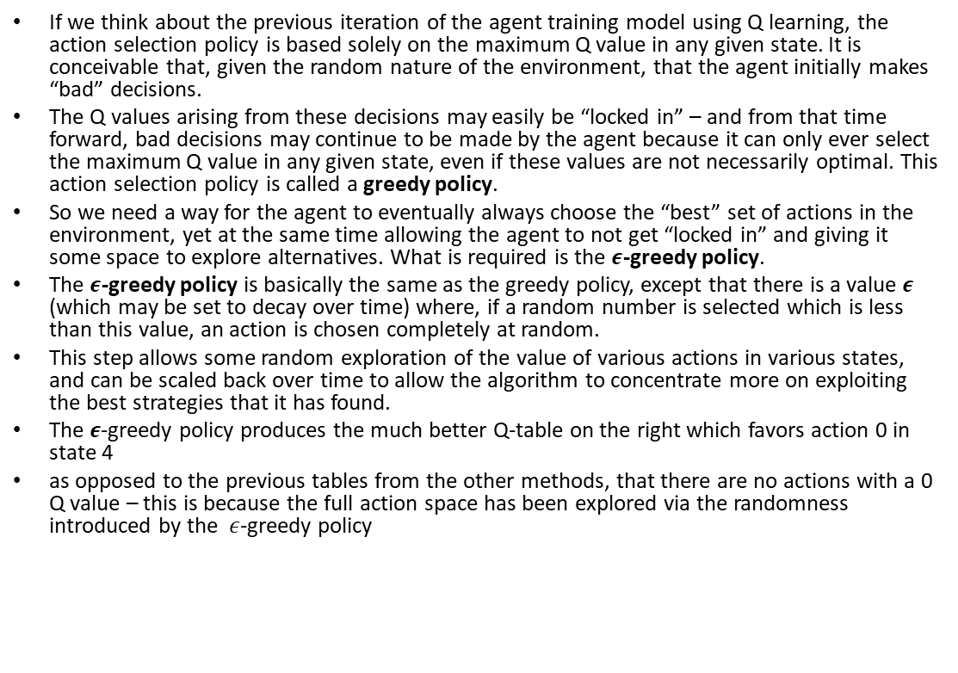
Q learning with $ε$-greedy action selection
If we think about the previous iteration of the agent training model using Q learning, the action selection policy is based solely on the maximum Q value in any given state. It is conceivable that, given the random nature of the environment, that the agent initially makes “bad” decisions.
The Q values arising from these decisions may easily be “locked in” – and from that time forward, bad decisions may continue to be made by the agent because it can only ever select the maximum Q value in any given state, even if these values are not necessarily optimal. This action selection policy is called a greedy policy.
So we need a way for the agent to eventually always choose the “best” set of actions in the environment, yet at the same time allowing the agent to not get “locked in” and giving it some space to explore alternatives. What is required is the $ε$-greedy policy.
The $ε$-greedy policy is basically the same as the greedy policy, except that there is a value $ε$ (which may be set to decay over time) where, if a random number is selected which is less than this value, an action is chosen completely at random.
This step allows some random exploration of the value of various actions in various states, and can be scaled back over time to allow the algorithm to concentrate more on exploiting the best strategies that it has found.
The 𝝐-greedy policy produces the much better Q-table on the right which favors action 0 in state 4
as opposed to the previous tables from the other methods, that there are no actions with a 0 Q value – this is because the full action space has been explored via the randomness introduced by the $ε$-greedy policy

Slide 22
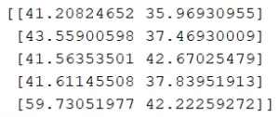
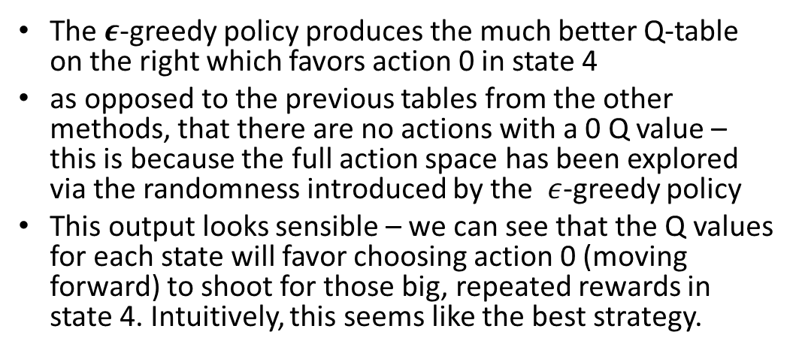
Finally! A working implementation of reinforcement learning
The 𝝐-greedy policy produces the much better Q-table on the right which favors action 0 in state 4
as opposed to the previous tables from the other methods, that there are no actions with a 0 Q value – this is because the full action space has been explored via the randomness introduced by the $ε$-greedy policy
This output looks sensible – we can see that the Q values for each state will favor choosing action 0 (moving forward) to shoot for those big, repeated rewards in state 4. Intuitively, this seems like the best strategy.

Slide 23
Where do neural networks fit in all this?
So far, we have been dealing with explicit tables to hold information about the best actions and which actions to choose in any given state.
However, while this is perfectly reasonable for a small environment like NChain, the table gets far too large and unwieldy for more complicated environments which have a huge number of states and potential actions.
Neural networks can be used in reinforcement learning. Instead of having explicit tables, instead we can train a neural network to predict Q-values for each action in a given state.

Slide 24
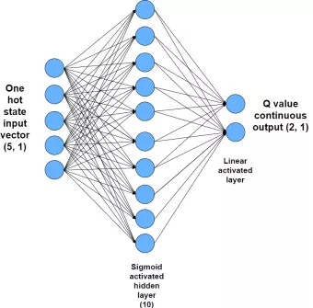
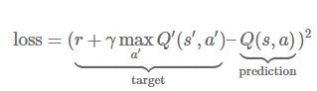
Neural network architecture for reinforcement learning
To develop a neural network which can perform Q learning, the input needs to be the current state (plus potentially some other information about the environment) and it needs to output the relevant Q values for each action in that state.
The Q values which are output should approach, as training progresses, the values produced in the Q learning updating rule. Therefore, the loss or cost function for the neural network should be:

Slide 25

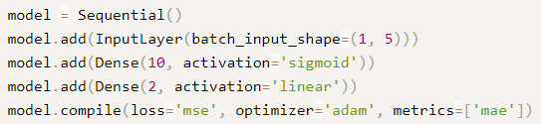
Building this network is easy in Keras
The input to the network is the one-hot encoded state vector.
For instance, the vector which corresponds to state 1 is [0, 1, 0, 0, 0] and state 3 is [0, 0, 0, 1, 0].
A hidden layer of 10 nodes with sigmoid activation is used.
The output layer is a linear activated set of two nodes, corresponding to the two Q values assigned to each state to represent the two possible actions.
Linear activation means that the output depends only on the linear summation of the inputs and the weights, with no additional function applied to that summation.
The linear activated output layer will yield the Q values for each action

Slide 26
To sum up
Supervised learning algorithms learn to perceive/encode/predict/classify patterns
But they do not learn to act in the more general sense of reinforcement learning in unknown environments
Without a teacher, solely from occasional real valued pain and pleasure signals, reinforcement learning agents must discover how to interact with a dynamic, initially unknown environment to maximize their expected cumulative reward signals
There may be arbitrary, a priori unknown delays between actions and perceivable consequences
A reinforcement learning system can be formed by a neural network controller C interacting with a deterministic, predictable environment, a separate neural network M can learn to become C’s world model through system identification, predicting C’s inputs from previous actions and inputs
Assuming M has learned to produce accurate predictions, we can use M to substitute the environment
Then M and C form an RNN where M’s outputs become inputs of C, whose outputs (actions) in turn become inputs of M
Back propagation can be used to achieve desired input events such as high real value reward signals

Slide 27
Practical: The CartPole environment
This is a 2D simulation in which a cart can be accelerated left or right in order to balance a pole placed on top of it.
After the environment is created, we must initialize it using the reset() method.
This returns the first observation.
Observations depend on the type of environment.
For the CartPole environment, each observation is a 1D NumPy array containing four floats:
The cart’s horizontal position (0.0 = center),
its velocity
the angle of the pole (0.0 = vertical),
and its angular velocity.
Note that there are actually two ways the agent can lose the game: either the pole can tilt too much, or the cart can go completely off the screen

